Slide 1

C++ project 2D Creation
By KeVIN DESCHARRIERES
Pr. yohan fougerolle
bsCV – 2016/2017
Ubfc – LE CREUSOT

Slide 2
Contents
Goal of the project
Interface
Tree and .txt file
DialogBox
Signal and slot
Issues
To go further
Conclusion

Slide 3
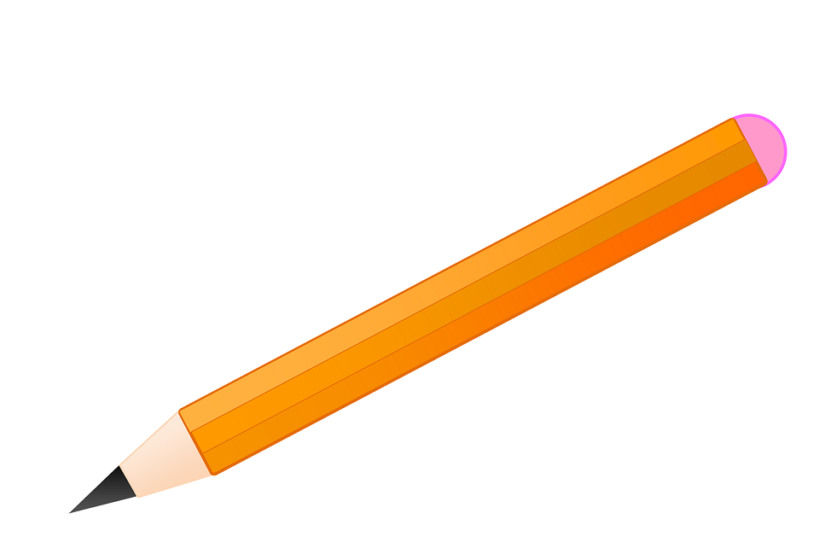
Goal of the project
2D graphical interface
Easy to use
Instinctive
Basic functions
Project from A to Z

Slide 4
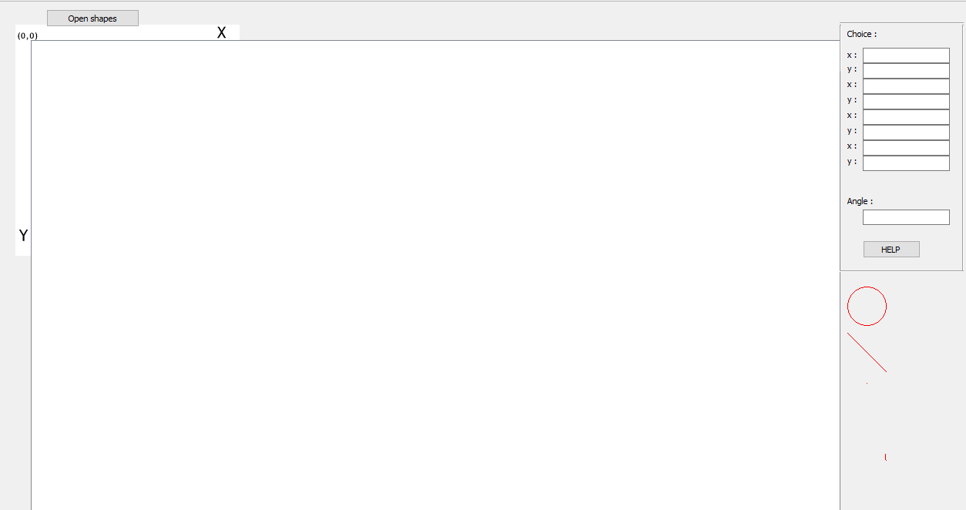
Interface
Axe
Choose coordinates
Open the window to choose an action
?
Do you need help?
Drawing Area
Do not forget your shape

Slide 5

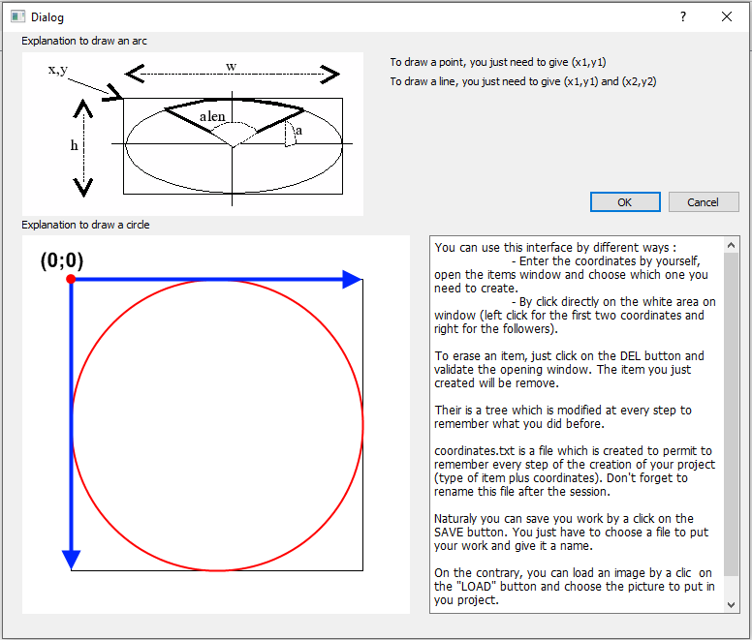
Interface
HELP Window
Different shapes
Tree
DEL SAVE & LOAD

Slide 6

Tree and .txt file
ui->comboBox->addItem("Line " + QString ::number(l));
l++;
Click on line button
Add to comboBox
Line + l
Check value of l

Slide 7
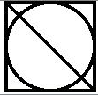
Tree and .txt file
File file("name_of_the_file.txt");
if (!file.open(QIODevice::WriteOnly | QIODevice::Append)) return;
QTextStream out(&file);
out << "Here what you need to write" ;
Coordinates.txt
line =>
xValue1 = 0
yValue1 = 0
xValue2 = 100
yValue2 = 100
Circle =>
xValue1 = 0
yValue1 = 0
xValue2 = 100
yValue2 = 100

Slide 8
DialogBox
//Openning of the window shapes
Void MainWindow::on_pushButton_released()
{
shapess->show();
}
Notes:
A messageBox is a means of communication between the user and the machine, ie the machine will wait for a response from the user before committing an action.
Creation of a new UI and call it in the mainWIndow

Slide 9
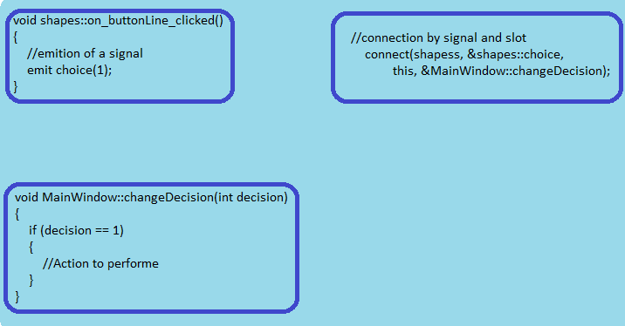
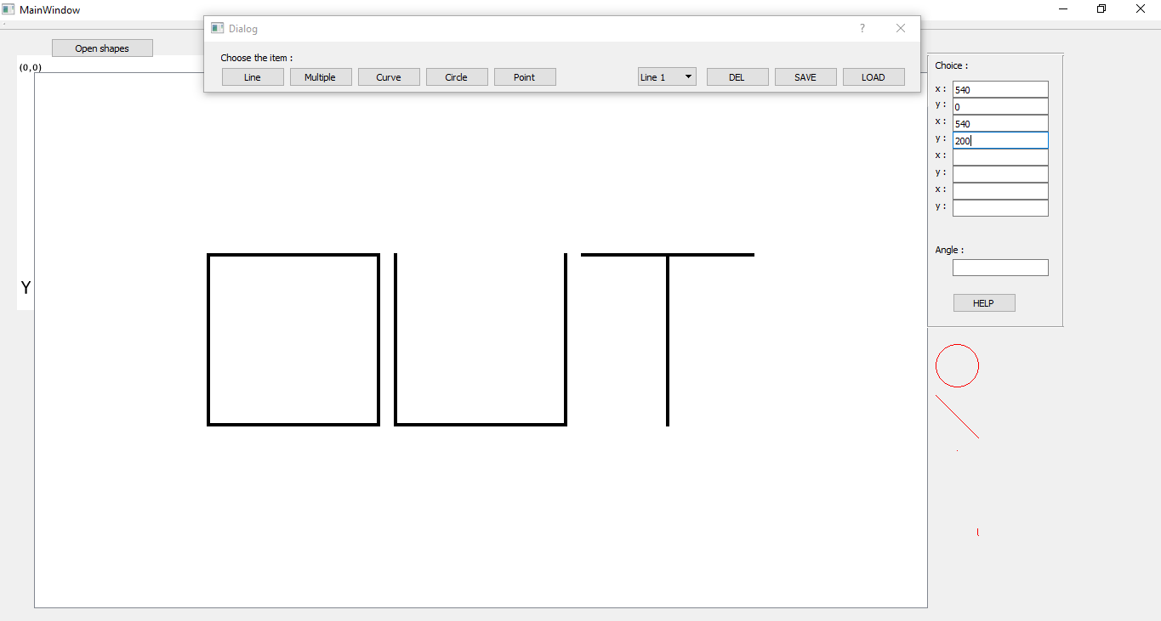
Signal and slot
Signal = Message sent by a widget when an event occurs
Slot = Function that is called when an event occurred
Notes:
The connection is made between the choice of our window shapess and the changeDecidion of our mainWindow class. You see here again an example where this is indispensable: you must be able to indicate a pointer to the current object (the window) and only this can do that!

Slide 10
Issues
Coordinates by Mouse Click
Shift between real coordinates and click coordinates
Try to solve the problem by erase the shift
Never the same shift
Widget to show the user choice
Widget is working
Problem from signal emition

Slide 11
To go further
Creation of the same application in 3D
Add some skins
Try to modify the size with the mouse
Add some keyboard short cuts

Slide 12
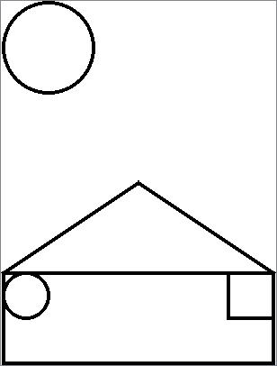
Demonstration?
How to create the following image in less than 5 moves?

Slide 13

Conclusion
Feel free to ask questions

Slide 14
Links for the project
http://stackoverflow.com/questions/7451183/how-to-create-image-file-from-qgraphicsscene-qgraphicsview
http://www.qtcentre.org/threads/22149-How-to-draw-a-semi-circle-or-arc-of-ellipse
http://doc.qt.io/
https://professor.yohan.fougerolle.com

